Slide 1

What will be the next
Disney Blockbuster?
Matt Weiper / Hema Vyas

Slide 2

What we want to Accomplish
Looking into data, which factors contribute to making a Disney movie better than the rest. Using our findings, can we predict which kind of Disney movies are going to be highly successful moving forward?
Questions we asked Ourselves
Does genre and rating factor into how the movies perform?
Does the month in which movie was released matter in terms of how much it grosses?
Drilling down data to last 10 years, does it represent the same answer we got for entire dataset?
What are some outside factors that could of determined the movies performance?

Slide 3
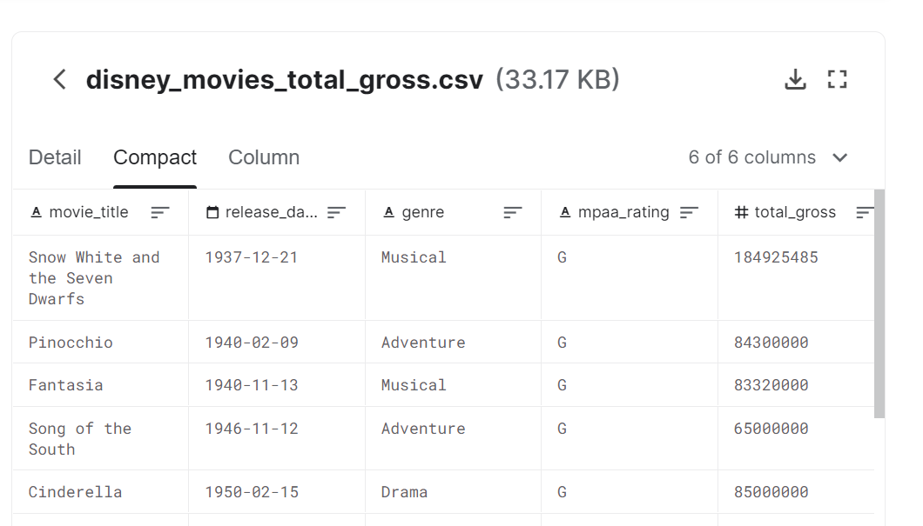

Getting Started
In order to get answers for our questions we wanted to find a good reliable dataset, which had columns for release data, genre, rating, and gross.
We believed with that data we could create new dataframes comparing specific columns, as well as creating plots to really give us answers in finding what makes a Disney blockbuster!
Dataset URL - https://www.kaggle.com/rashikrahmanpritom/disney-movies-19372016-total-gross

Slide 4
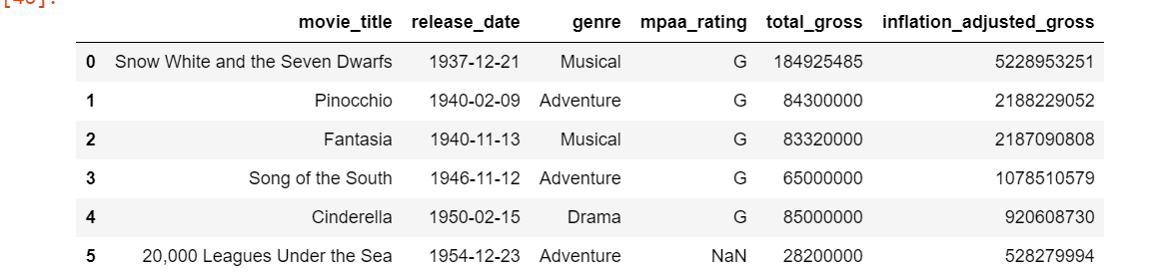

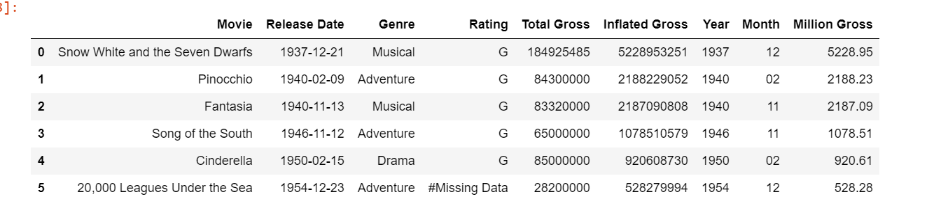
Data Cleanup
Before
The dataset used is from 1937-2016
For all our analysis we are using inflated adjusted gross
After

Slide 5
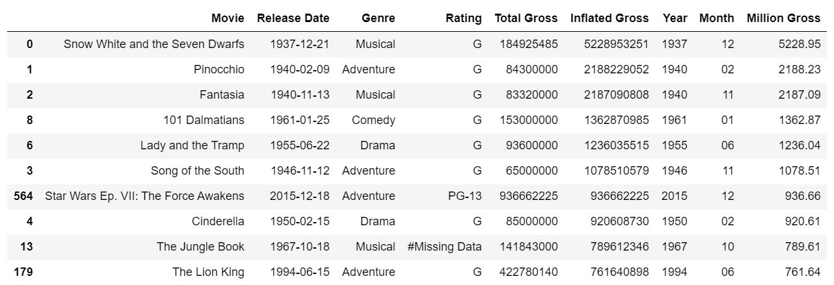

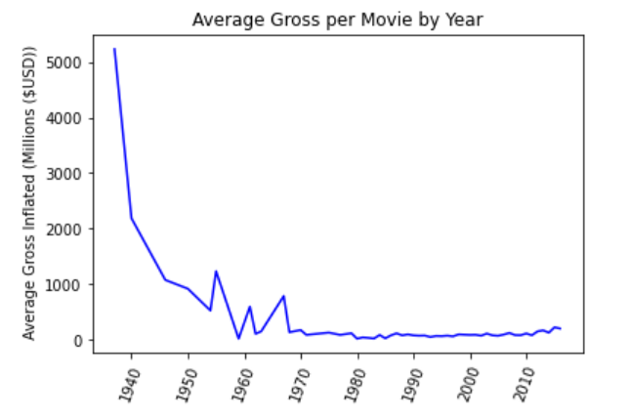
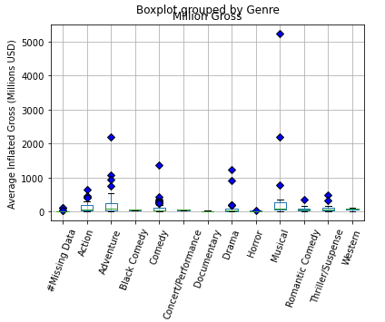
Look at the Top 10 Movies
Skewed data from early Disney days (Not as many alternatives)

Slide 6
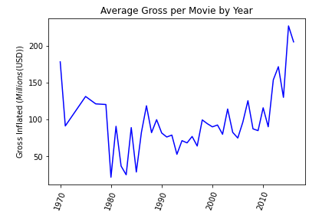

Filter Data from 1970-2016
What outside factors could be causing these dips?

Slide 7
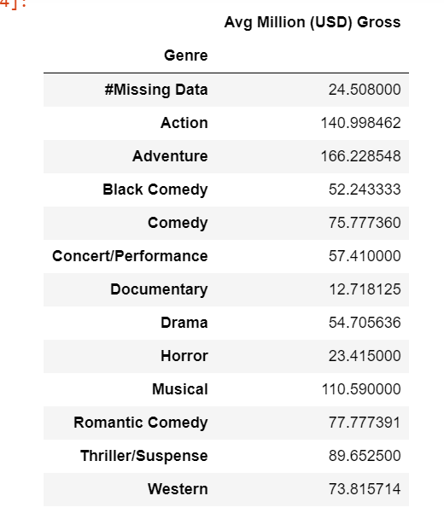
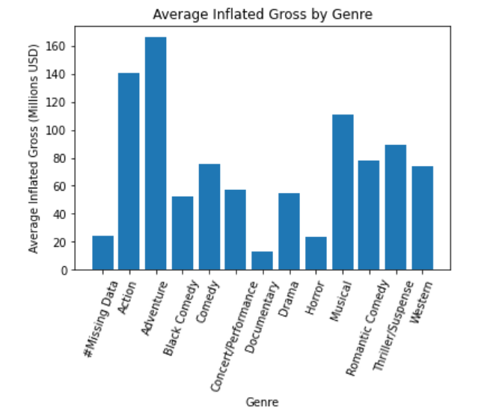
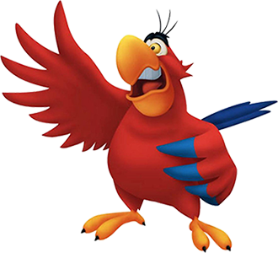
What information can we gather by looking at Genre?
Avg Inflated gross per movie by genre

Slide 8
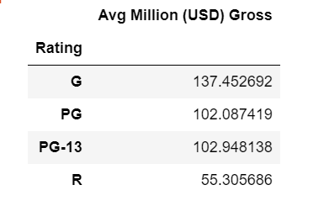
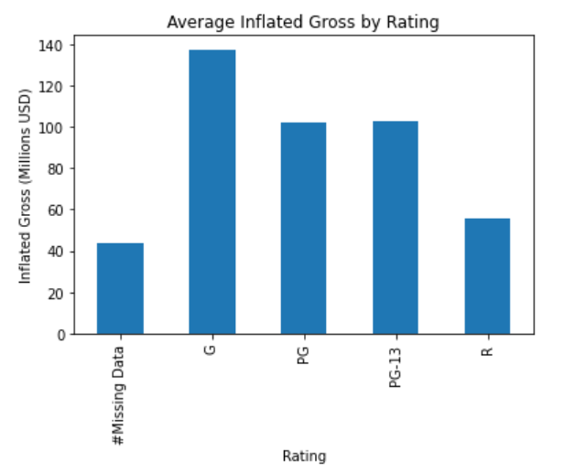

What information can we gather by looking at Rating?
Avg Inflated gross per movie by rating

Slide 9
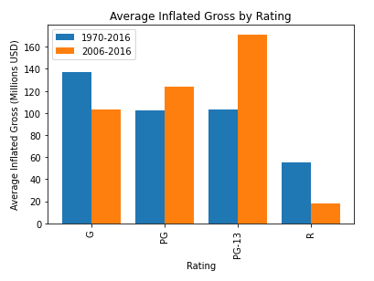
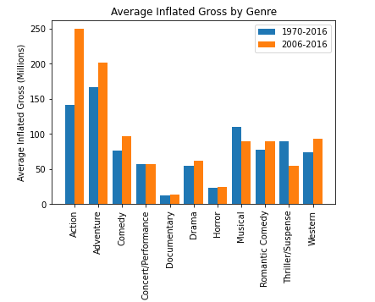
Comparison to Current Day
In order to find next blockbuster we wanted to just look at data for the last 10 years and compare to the rest of our data
*Disney acquired Marvel Entertainment in 2009, and LucasFilm in 2012

Slide 10
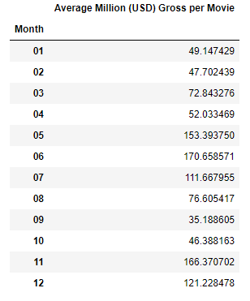
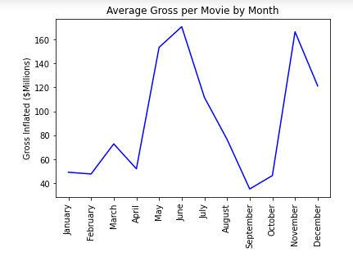

Monthly Data
What do we think contributed to some months being higher than others?

Slide 11

Takeaways
What conclusions can we draw from our analysis to make prediction for next blockbuster?
Did we find all the answers we were looking for?
Difficulties we ran into
Other questions we encountered

Slide 12
The Next Disney Blockbuster
will be…
Action/Adventure
Rated PG-13
Released in summer or winter months

Slide 13
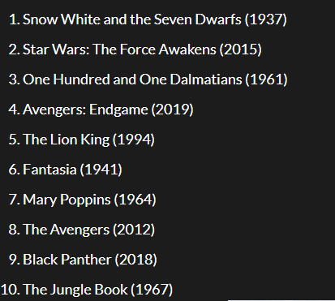

Was our guess accurate?
All-time gross (adjusted for inflation
Avengers: End Game
Action/Sci-Fi
Rated PG-13
Released 04/26/19
Black Panther
Action/Adventure
Rated PG-13
Released 2/16/18

